Slide 1

Art Curators about cultural paradigm shifts
Alicja Kutek alk36
Aberystwyth University 2019

Slide 2
Introduction

Slide 3
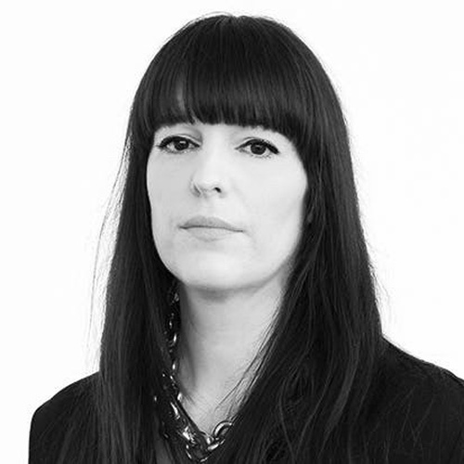

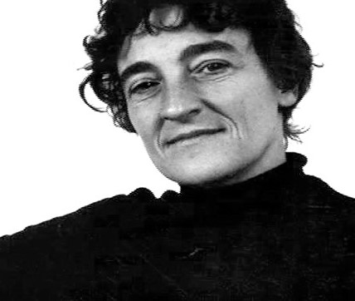
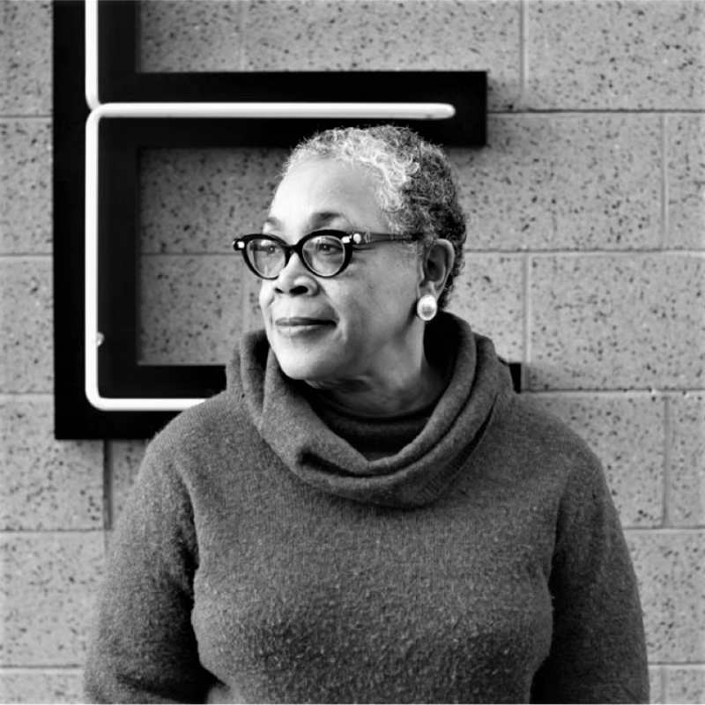
Lucy Lippard
Lowery Stokes Sims
Eva Respini
Vincent Honore
The Barbara Lee Chief Curator at the ICAI Boston
Director and Chef Curator, writer , Independent Curator
American writer ,art critic activist and curator
Retired Curator at the museum of Arts and Design

Slide 4
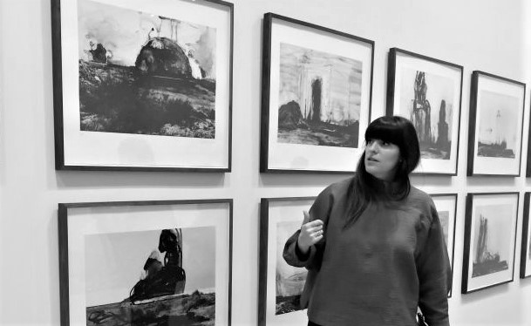
Eva Respini
Published numerous books and catalogues , museum publications
Organised numerous exhibitions of contemporary Art & Photography
Specialises in global contemporary art and image-making practices
Skills :
Curatorial Leadership
Commitment to curatorial craft at every level of exhibition-making
Traveller – all her multiple research travels gave her a unique worldview that she brings to her curatorial work
The Barbara Lee Chief Curator at the ICAI Boston (since 2015)
Used to be a curator at the Museum of Modern Art
BA & MA in Art History
Since 2014 Fellow at the Centre for Curatorial Leadership
Visiting Lecturer, critic, speaker at a numerous of universities

Slide 5
Art in the Age of the Internet , 1989 to Today

Slide 6
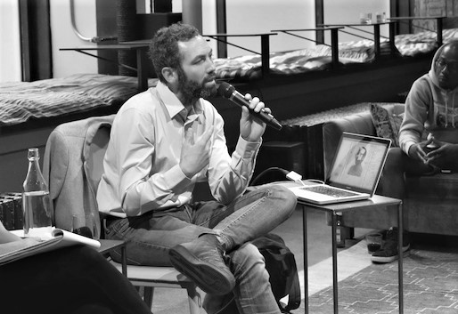
Vincent Honore
His work leaves an unforgettable impression on the world of art
Why curator? To fully embrace contemporary Art
Favourite part about curating process:
To engage with artist
To research
To debate
To share
To produce
Contextualizing artworks
Positioning the artworks in an exhibition
Previously ,he wanted to become a teacher to teach & to learn , but he quickly realised that as a curator he will still be able to learn new things
Curious Curator – Director and Chief Curator, writer based in London and Paris
Has an experience that includes roles in the Palais de Tokyo and Tate Modern
Since October 2017 Senior Curator at Hayward Gallery in London

Slide 7

Kiss My Genders

Slide 8
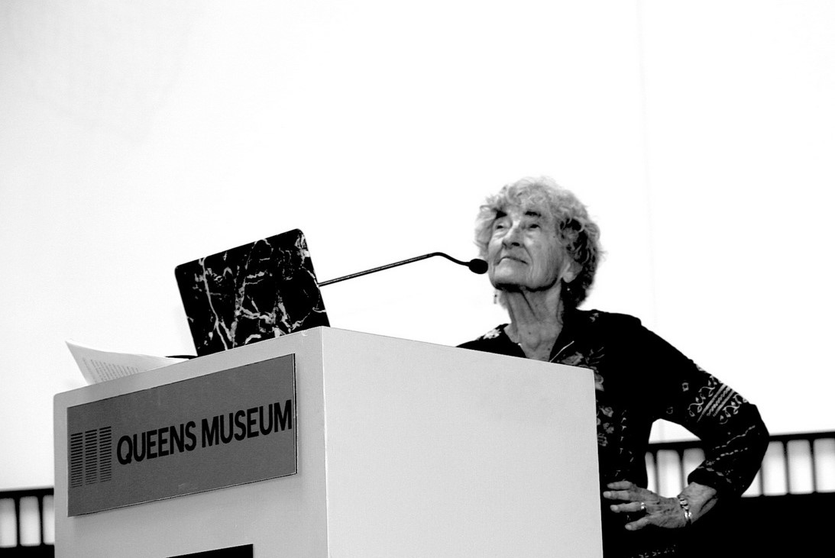

Lucy R.Lippard

Slide 9


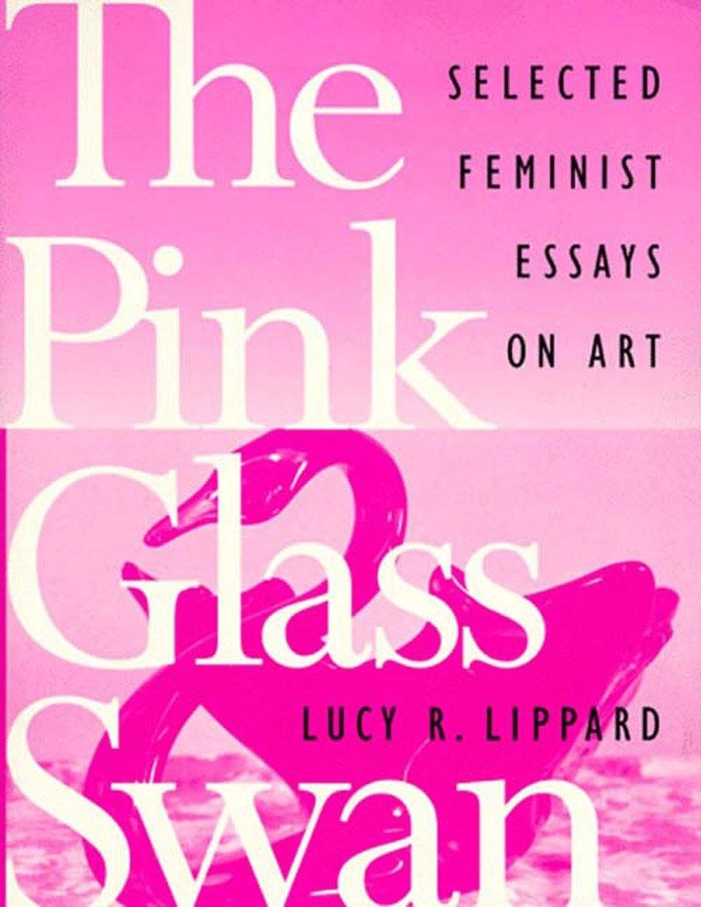
The Pink Glass Swan. Selected feminist essays on art.

Slide 10
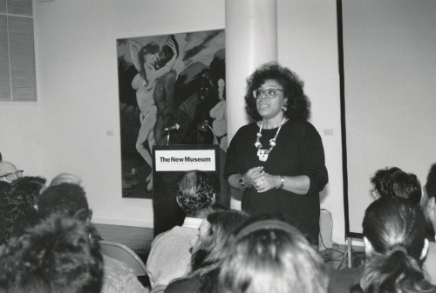
Lowery Stokes Sims
Since the 1970s she has given the opportiunity for artists involve with the black art movement, the feminist art movement and the politics of postmodernism and beyond
While working for MMA she helped build the museums's collection by adding works by different African –American artists
Not just agreat curator for African-Amercian work, but as well-respected curator of any genre
Retired Curator at the museum of Arts and Design
Education and curatorial staff of the Metropolitan Museum of Arts (1972- 1999) where she cureted over 30 exhibitions
Specialised in modern and contemporary Art best known for her particular experience in the work of African, Latino and Asian –American artists.
She has lectured and guest cuarted exhibitions nationally and internationally

Slide 11
Art and Race Matters , the career of Robert Colescott

Slide 12
Key area of Interst – Cultural Paradigm Shifs
Internet-The impact of the technology on everyone’s life , on art , how the internet changed the way in which we are learning , how we gets inspirations , we know more about different fashions , about different cultures , we have bigger spectrum of technics , we can communicate with different countries , we can learn from them , be more social , more understanding etc..
Gender Tolerance – we are becoming more tolerance and open minded towards people in general , all the LGBTq+ rights are being considered by governments , some people still can not accept how someone can identify gender with personality , but societies are changing and people finally after centuries are becoming more aware that every person has the same rights and is equal.
Feminism – that’s a paradigm that has been taken under consideration a while ago , without it women wouldn’t have any right ,would nt be treated on the same level as men, in some spectrums women are still treated in a different way than men , sometimes its hard to notice that , because of the habit that societies have adapt ,which is why we still have to underline and speak about same human rights
Racism – the matter of race , it got to our culture as a tolerancy (again) but becaue of the fact that it used to be sop stporng in our history (specioally American history) it came to the culture nowadays , obviously racism is a horrible thing that cause dlots of pain and deaths ,but somwtimes we can not just over lap something and we haave to accept the culture that different racfes created , the Robert colescott not otnly captured the racism in his art but also shown the absurd of it in a funny way ,maybe by using a black humor but still , not sad way

Slide 13

3 key questions
1. Do the cultural paradigm shifts have any impact on Art?
2. What impact does the Art have on the society ?
3.How does Art help to understand different changes / paradigm shifts in the society ? Does it at all?

Slide 14
Bibliography
https://www.linkedin.com › lowery-sims-2b255422
https://en.wikipedia.org › wiki › Lowery_Stokes_Sims
https://art.arts.uci.edu › lowery-stokes-sims
https://www.encyclopedia.com/education/news-wires-white-papers-and-books/sims-lowery-stokes-1949
https://www.artnews.com/art-news/news/i-was-really-a-nerd-lowery-stokes-sims-at-arttables-2017-benefit-8194/

Slide 15
conclusion

